Slide 1



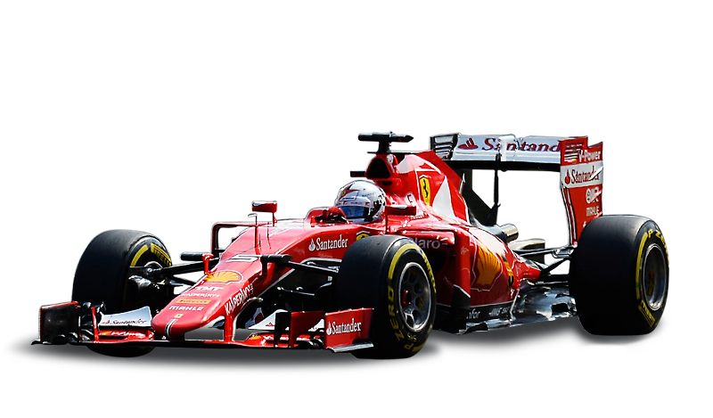

SC1015 MINI PROJECT
FORMULA 1
Tan Jun Wei Adison (U2321020A)
Isaac Leow (U2322697H)
Goh Jin Long Abdillah (U2321634L)
FCEA, Lab Group 8

Slide 2




CONTENT PAGE
1
5
Project Motivation
Exploratory Data Analysis (EDA)
2
6
Objective & Problem Statements
Machine Learning (ML) Modules
3
7
Our Data Set
Project Outcome
4
8
Data Preparation & Cleaning
Data-driven Insights

Slide 3





FORMULA 1 STATS
2021 revenue = $2.136 billion
2022 revenue = $2.573 billion
2023 revenue = $3.2 billion
2022 attendance = 5.7 million
2023 attendance = 6.15 million

Slide 4
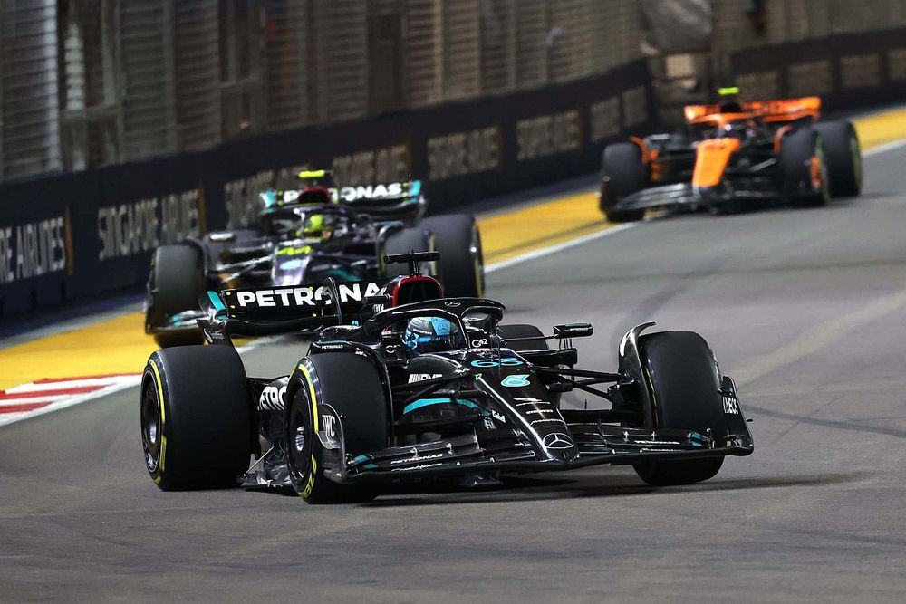
FORMULA 1 IN SINGAPORE
The only night race in F1 has generated > $1.5 Billion in incremental tourism receipts.
> 550,000 unique international visitors.
All organisations from the GP is Singapore-based.

Slide 5
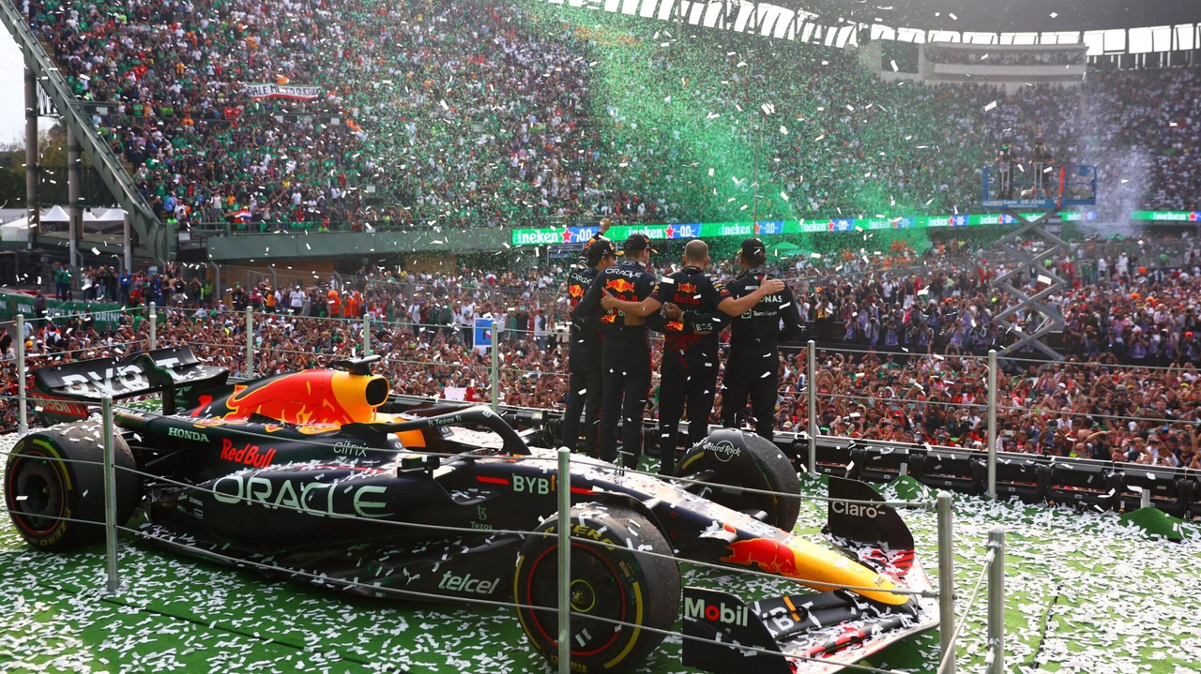
WHY IS WINNING SO IMPORTANT IN F1?
For eg, in 2024, the most dominant constructor RedBull entered the season with $7.4 M in spending whilst Haas, the last in constructors in 2023, only had $700k to spend.

Slide 6
OUR OBJECTIVES
Leverage on Machine Learning (ML), given race factors to:
formulate time-crucial race strategies to secure better finishing positions.
improve planning by teams for future courses of action given current data, such as areas of improvement, to increase race excitability.
gauge performance and position of a driver.

Slide 7

ABSTRACTION

Slide 8
PROBLEM STATEMENT
“How can we utilise machine learning to accurately predict the top 5 drivers given factors of a race?”

Slide 9


OUR DATA SET
Mitchell Gleason
Official Formula 1

Slide 10
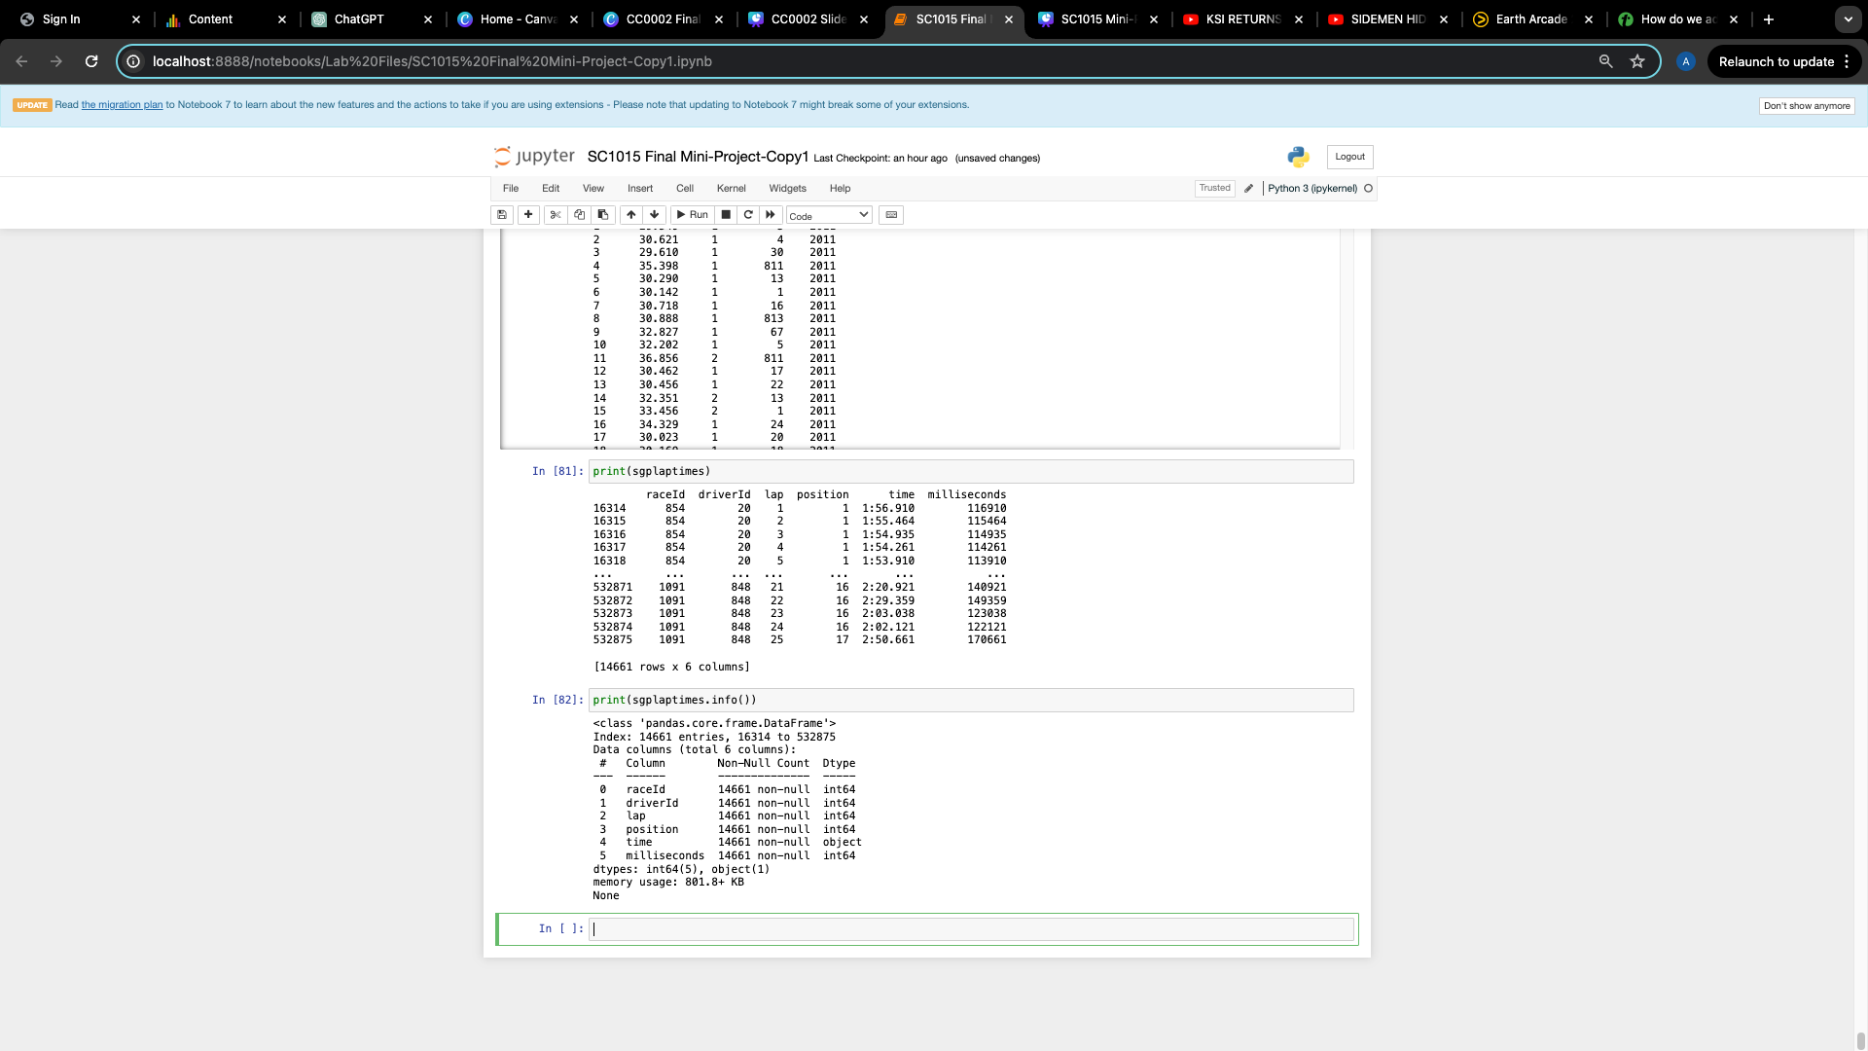
INITIAL DATA INSIGHTS/ LAPTIME
Singapore Grand Prix driver lap times dataframe.

Slide 11
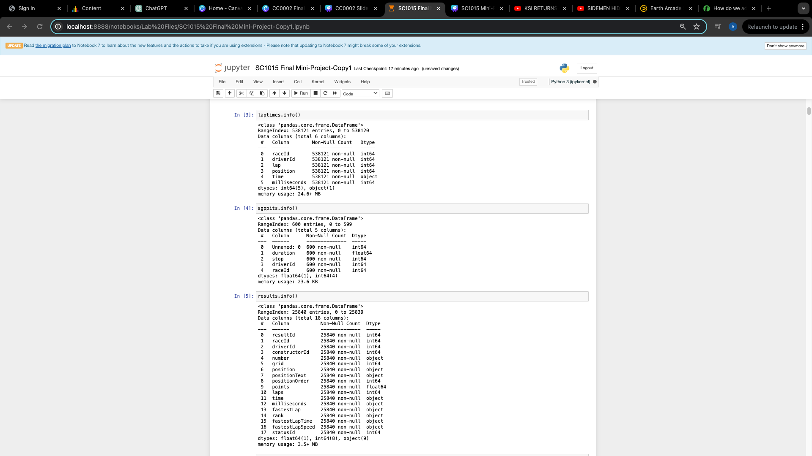
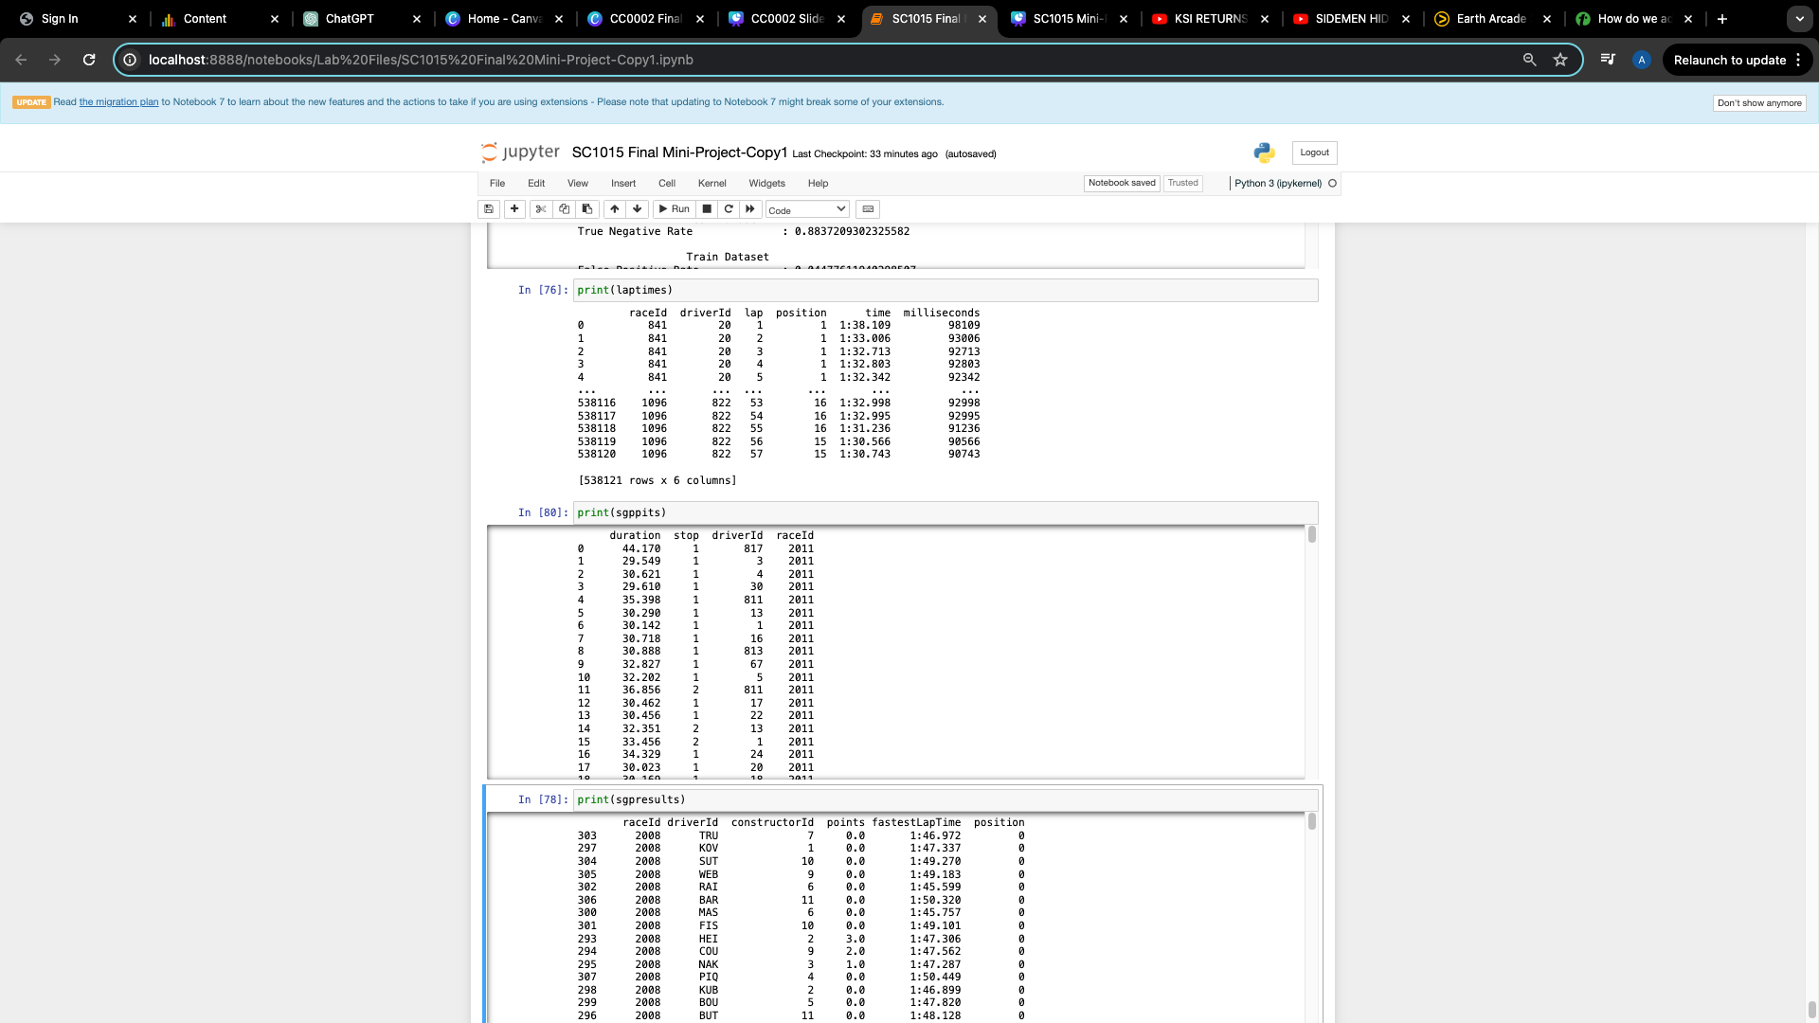
INITIAL DATA INSIGHTS/PITSTOP
Singapore Grand Prix pitstop timing dataframe.

Slide 12
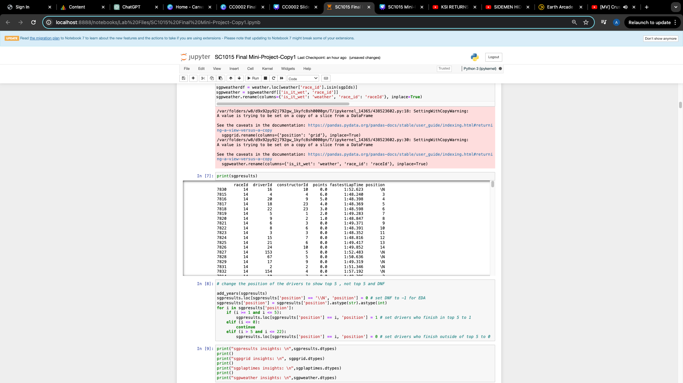
INITIAL DATA INSIGHTS/PITSTOP
Singapore Grand Prix fastest lap timing dataframe.

Slide 13
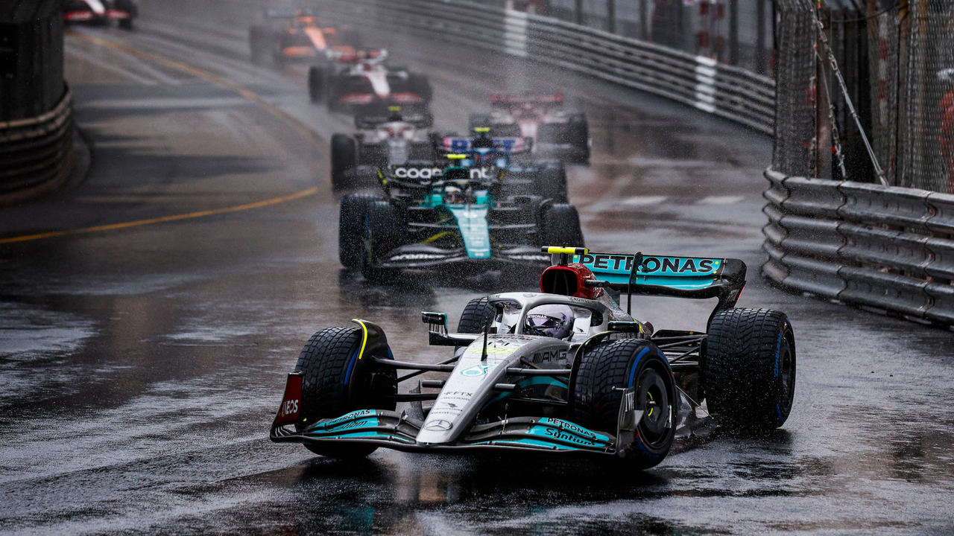
ABSTRACTION
Our Variables:
Average lap time.
Average pitstop time.
Driver fastest lap time.
Driver starting grid position.
Weather conditions (wet / not wet).

Slide 14


DATA PREPARATION & CLEANING

Slide 15
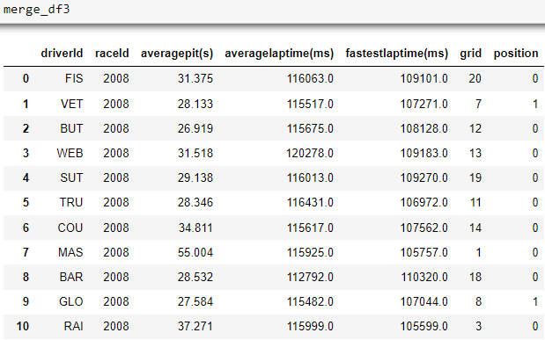
1 | Calculate average lap times and pitstop times
DATA PREPARATION AND CLEANING
2 | Converted fastest lap times from a string to a float
3 | Dropped unimportant/repeated data
4 | Merged all the data frames together
5 | Changed positions to 0/1, indicating top 5
6 | Changed driverId and raceId to code names and race years

Slide 16

EXPLORATORY DATA ANALYSIS
UNI-VARIATE VISUALIZATION

Slide 17
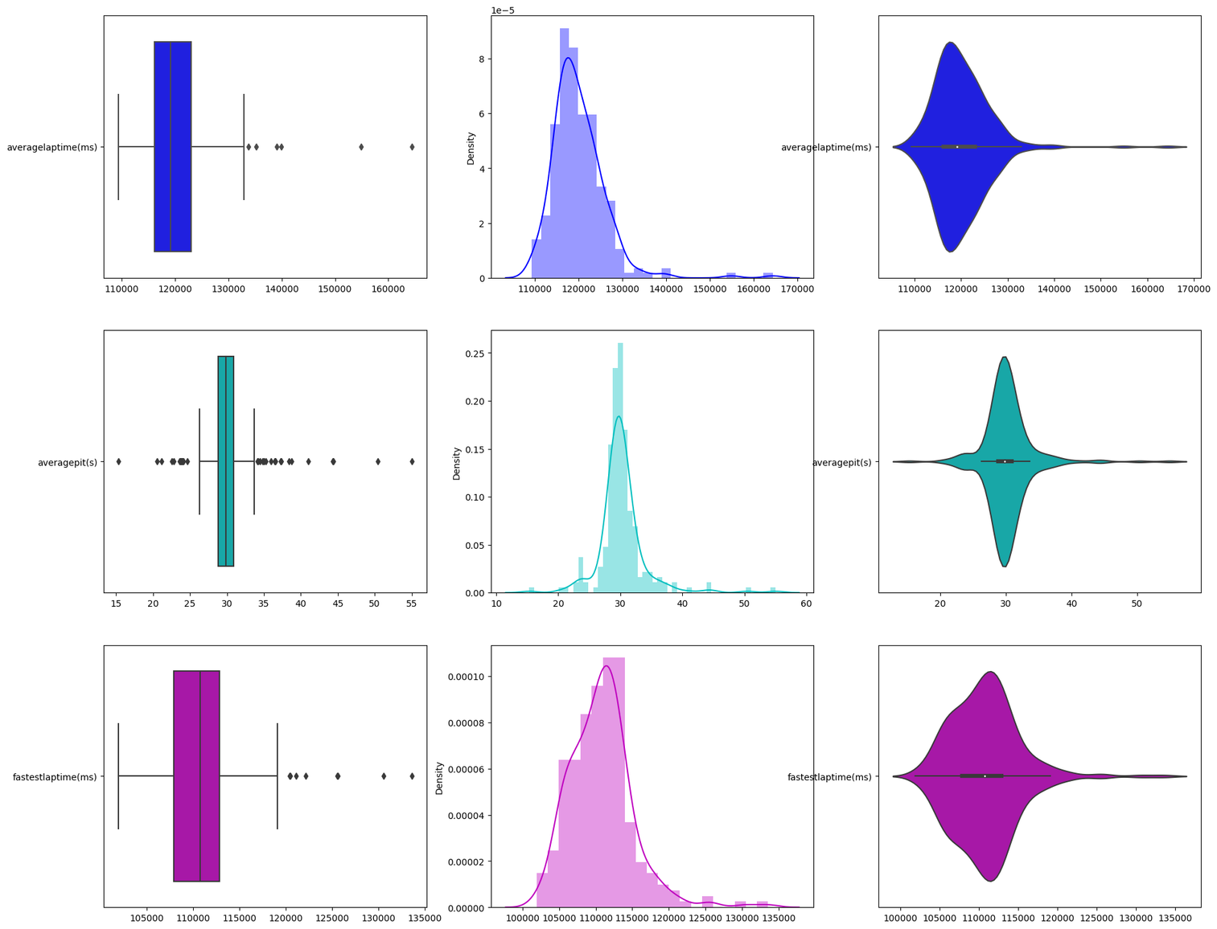
UNI-VARIATE VISUALIZATION
Average lap time (ms)
Average pitstop time (s)
Fastest lap time (ms)

Slide 18
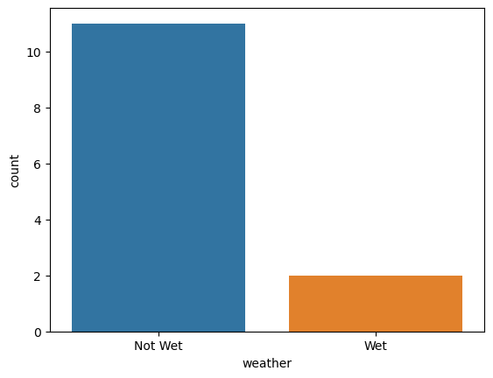
UNI-VARIATE VISUALIZATION
Singapore GP weather conditions.

Slide 19
EXPLORATORY DATA ANALYSIS
BI-VARIATE VISUALIZATION

Slide 20
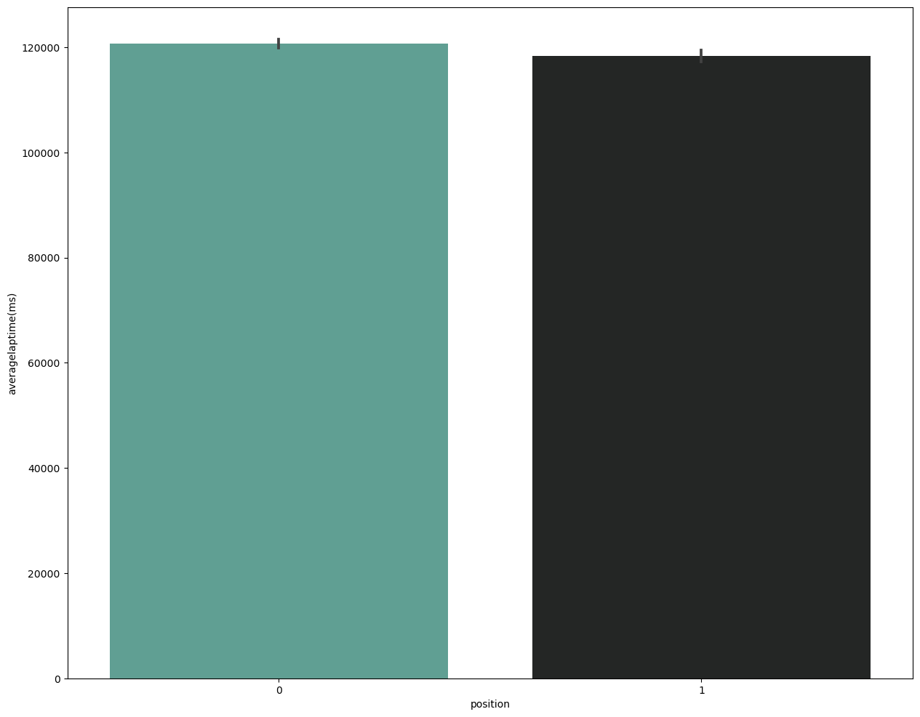
BI-VARIATE VISUALIZATION
Average lap times (ms) vs Position
0
1
0
1
0
1

Slide 21
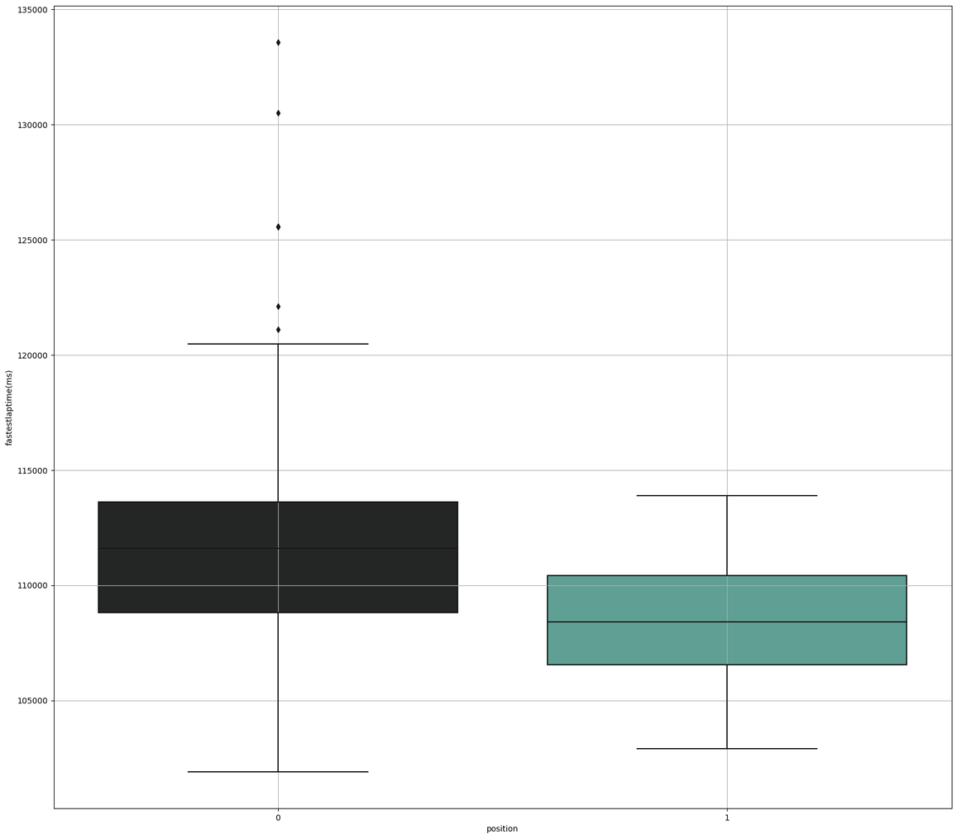
BI-VARIATE VISUALIZATION
Fastest lap times (ms) vs Position
1
0
1

Slide 22
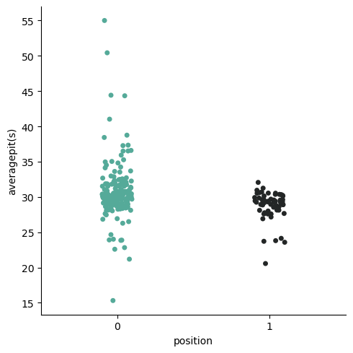
BI-VARIATE VISUALIZATION
Average pitstop (s) vs Position
0
1

Slide 23
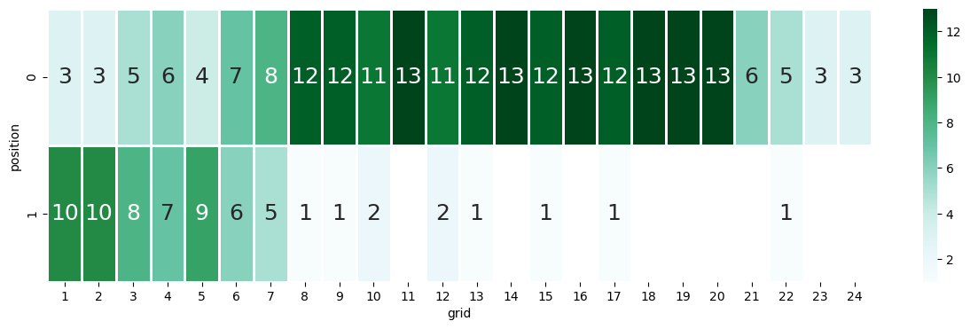
BI-VARIATE VISUALIZATION
Starting grid positions vs Position
0

Slide 24
EXPLORATORY DATA ANALYSIS
MULTI-VARIATE VISUALIZATION

Slide 25
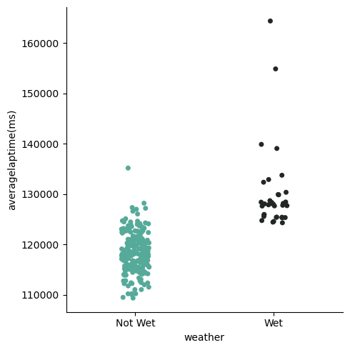
MULTI-VARIATE VISUALIZATION
Average lap time (ms) vs weather

Slide 26
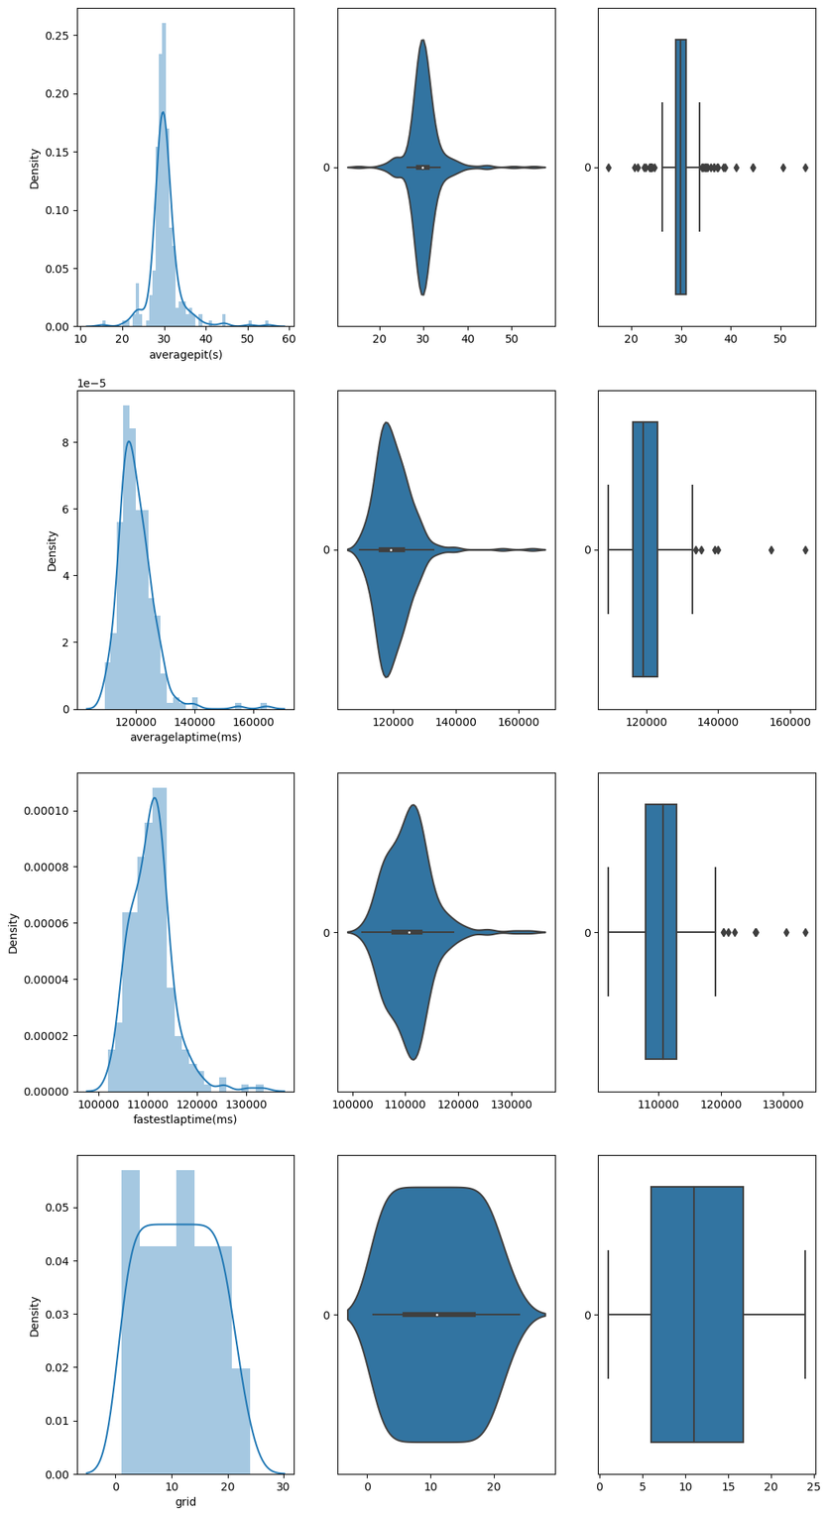
MULTI-VARIATE VISUALIZATION
Average pitstop time (s)
Average lap time (ms)
Fastest lap time (ms)

Slide 27
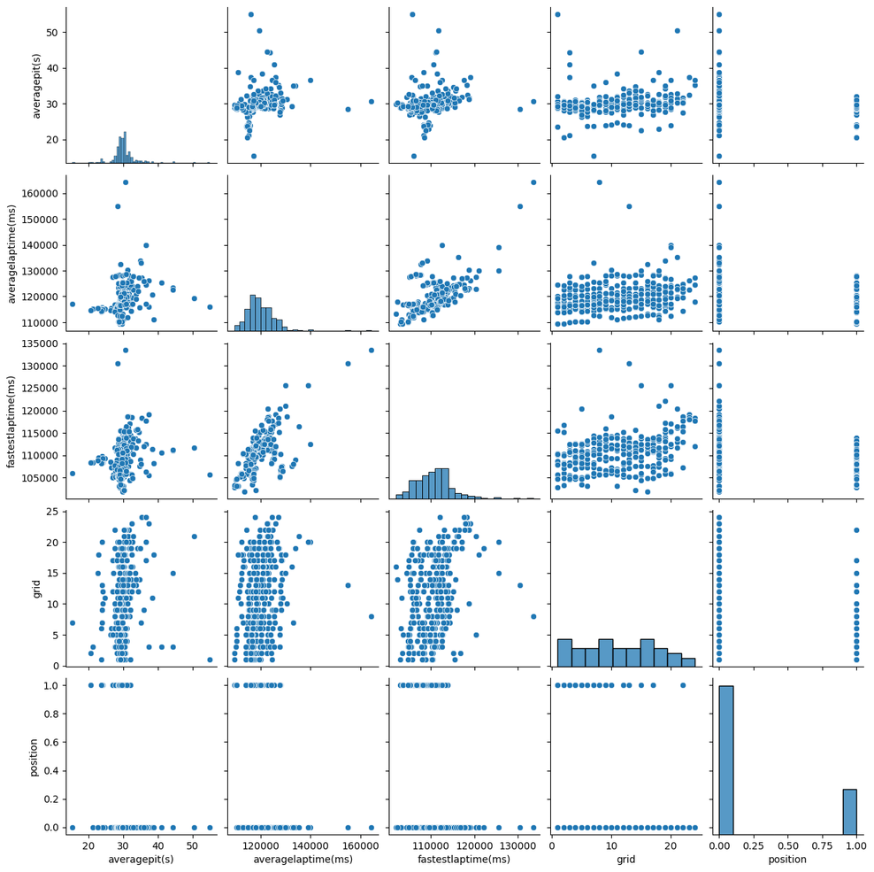
MULTI-VARIATE VISUALIZATION
Average pitstop time (s)
Average lap time (ms)
Fastest lap time (ms)
Starting grid positions
Position
Average pitstop time (s)
Average lap time (ms)
Fastest lap time (ms)
Starting grid positions
Position

Slide 28
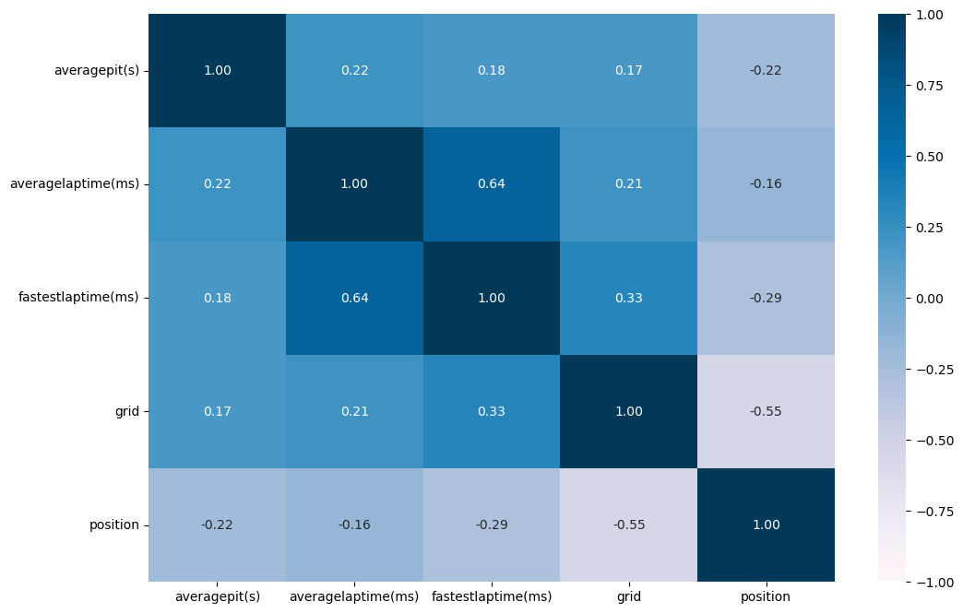
MULTI-VARIATE VISUALIZATION

Slide 29
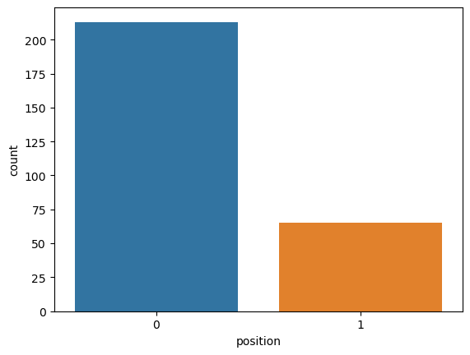
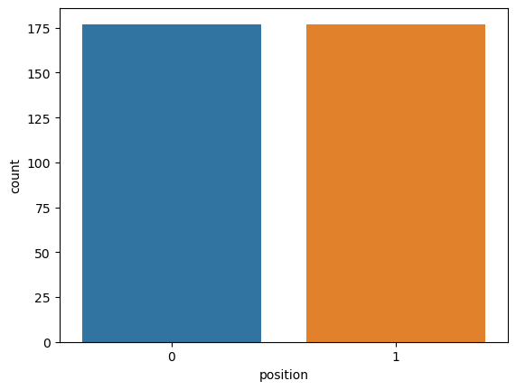
UPSAMPLING
Before upsampling
After upsampling

Slide 30
MACHINE LEARNING (ML) MODULES

Slide 31
MACHINE LEARNING (ML) MODULES
1 | Classification tree
Random Forest
2 | Logistic Regression
GridSearchCV
3 | Support Vector Machines

Slide 32
MACHINE LEARNING
CLASSIFICATION TREE

Slide 33
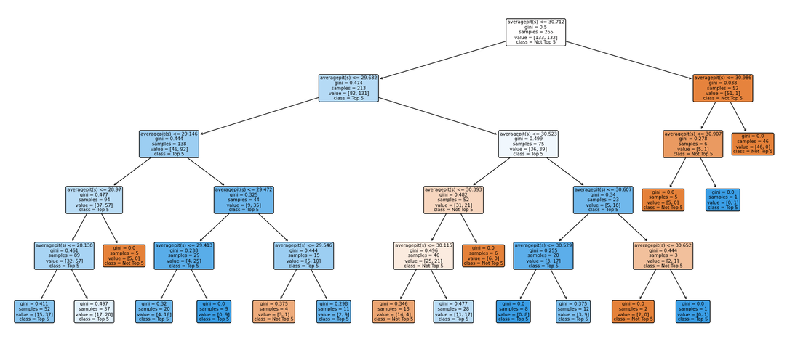
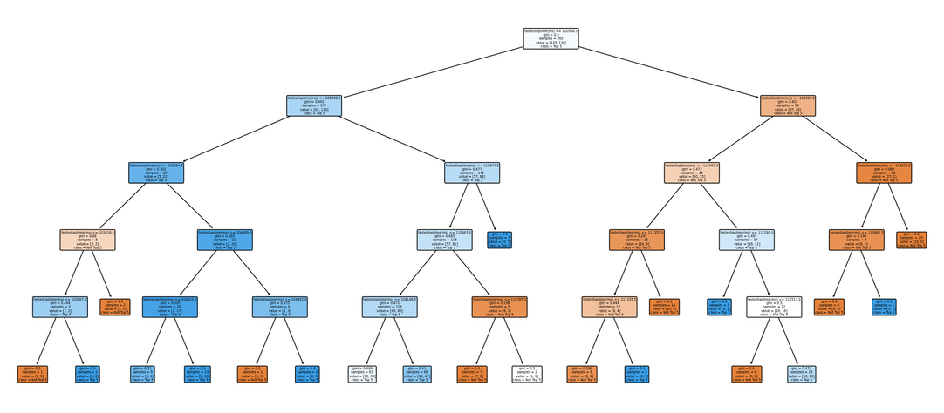
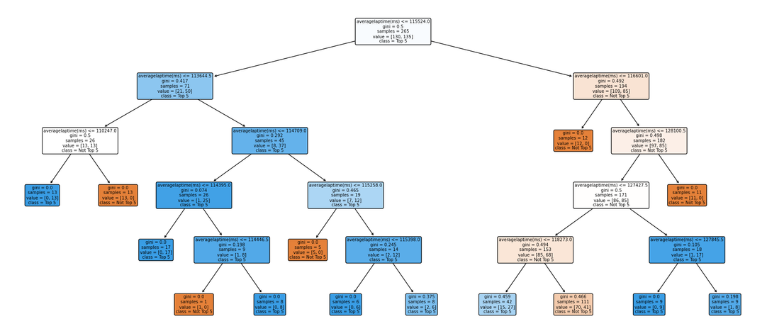
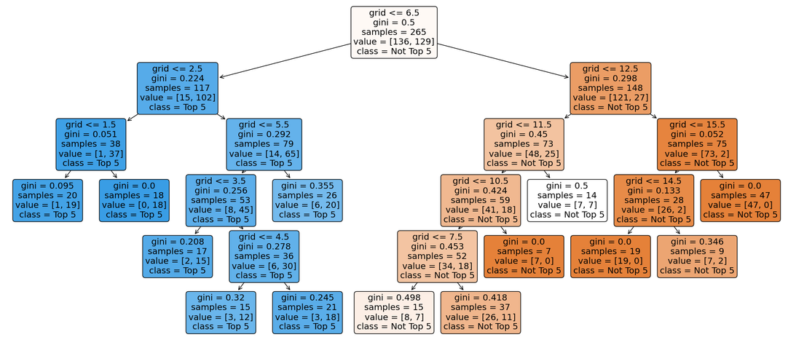
UNI-VARIATE CLASSIFICATION
Average pitstop time (s)
Fastest lap time (ms)
Average lap time (ms)
Starting grid positions

Slide 34
UNI-VARIATE CLASSIFICATION
 | CLASSIFICATION ACCURACY/ TRAIN | CLASSIFICATION ACCURACY/ TEST
AVERAGE LAP TIME (MS) | 0.7773584905660378 | 0.7191011235955056
AVERAGE PITSTOP TIME (S) | 0.7849056603773585 | 0.7078651685393258
FASTEST LAP TIME (MS) | 0.7660377358490567 | 0.7078651685393258
STARTING GRID POSITION | 0.8415094339622642 | 0.8202247191011236
Tree depth 5

Slide 35
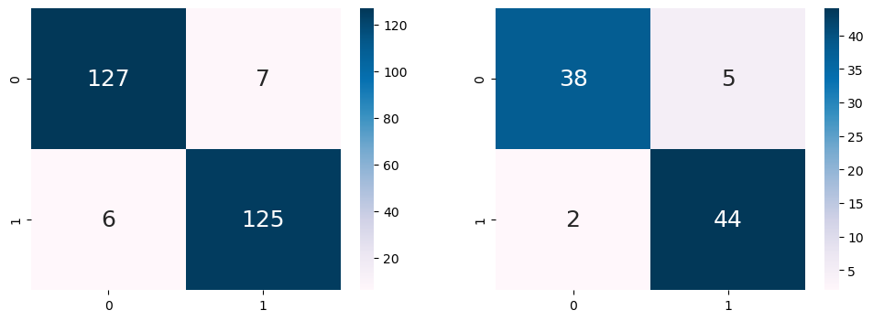
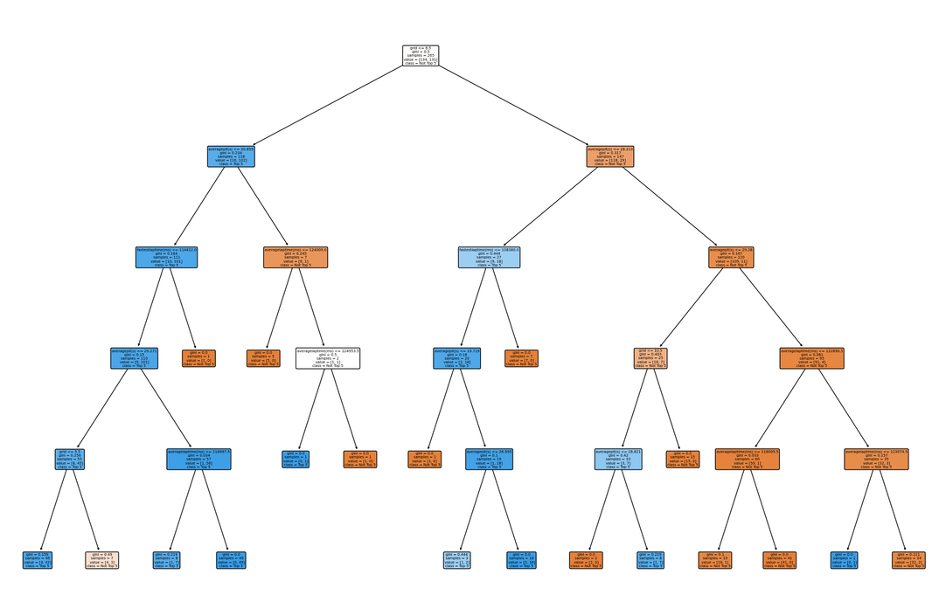
MULTI-VARIATE CLASSIFICATION
Train Dataset
Classification Accuracy : 0.9509433962264151
Test Dataset
Classification Accuracy : 0.9213483146067416
Train Dataset
True Positive Rate : 0.9541984732824428
Test Dataset
True Positive Rate : 0.9565217391304348
Train Dataset
True Negative Rate : 0.9477611940298507
Test Dataset
True Negative Rate : 0.8837209302325582

Slide 36
MACHINE LEARNING
SUPPORT VECTOR MACHINE & LOGISTIC REGRESSION

Slide 37
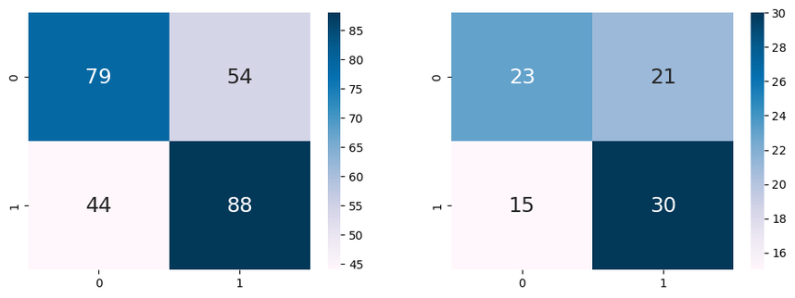
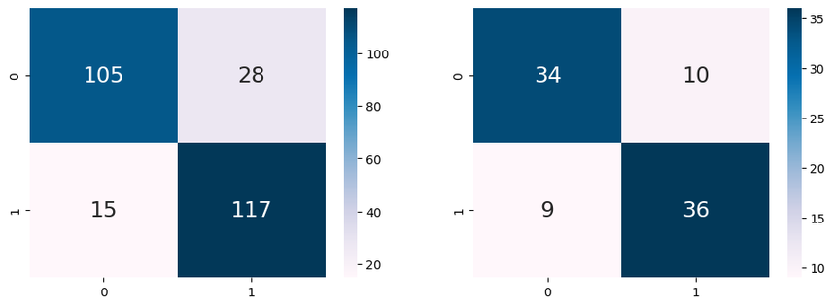
SVM & LOGISTIC REGRESSION
 | CLASSIFICATION ACCURACY/ TRAIN | CLASSIFICATION ACCURACY/ TEST
SUPPORT VECTOR MACHINE (SVM) | 0.630188679245283 | 0.5955056179775281
LOGISTIC REGRESSION | 0.8377358490566038 | 0.7865168539325843
MULTI-VARIATE CLASSIFICATION TREE | 0.9509433962264151 | 0.9213483146067416
Support Vector Machine
Logistic Regression

Slide 38
MACHINE LEARNING
RANDOM FOREST

Slide 39
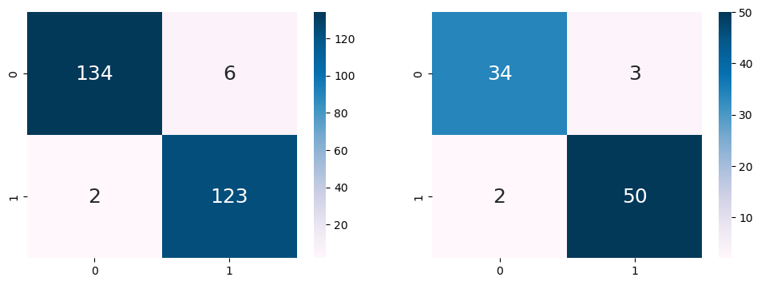
RANDOM FOREST
Train Data: Depth 5
Train Dataset
Classification Accuracy : 0.969811320754717
Test Dataset
Classification Accuracy : 0.9438202247191011
Train Dataset
True Positive Rate : 0.984
Test Dataset
True Positive Rate : 0.9615384615384616
Train Dataset
True Negative Rate : 0.9571428571428572
Test Dataset
True Negative Rate : 0.918918918918919
Test Data: Depth 5

Slide 40
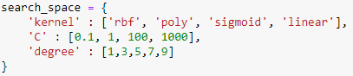
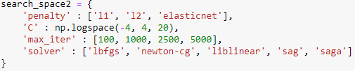
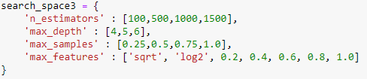
GRID SEARCH
1 | Support Vector Machines
2 | Logistic Regression
3 | Random Forest

Slide 41
GRID SEARCH RESULTS
CLASSIFICATION ACCURACY | CLASSIFICATION ACCURACY | CLASSIFICATION ACCURACY | CLASSIFICATION ACCURACY | CLASSIFICATION ACCURACY | CLASSIFICATION ACCURACY
 | BEFORE HYPERPARAMETER TUNING | BEFORE HYPERPARAMETER TUNING |  | AFTER HYPERPARAMETER TUNING | AFTER HYPERPARAMETER TUNING
 | TRAIN | TEST |  | TRAIN | TEST
SUPPORT VECTOR MACHINE (SVM) | 0.630188679245283 | 0.5955056179775281 |  | 0.7584905660377359 | 0.797752808988764
LOGISTIC REGRESSION | 0.8377358490566038 | 0.7865168539325843 |  | 0.8566037735849057 | 0.8426966292134831
RANDOM FOREST | 0.969811320754717 | 0.9438202247191011 |  | 0.9773584905660377 | 0.9438202247191011

Slide 42
PROJECT OUTCOME

Slide 43
CONCLUSION
WHAT WE LEARNT
1 | Able to predict top 5 with relatively high accuracy in Singapore
1 | Logistic Regression, SVM and Random Forest machine learning models
2 | F1 Teams can see which department they are lacking in and work to improve on them
2 | Hypertuning our parameters using GridSearchCV
3 | Model has not been tested overseas, effectiveness is unconfirmed if model is used in other countries
4 | 3 of the prediction variables would be difficult to obtain when watching f1 race in real time

Slide 44
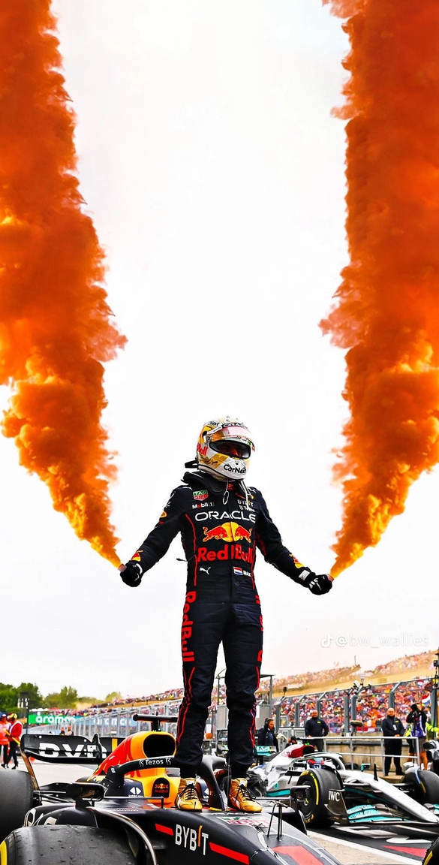
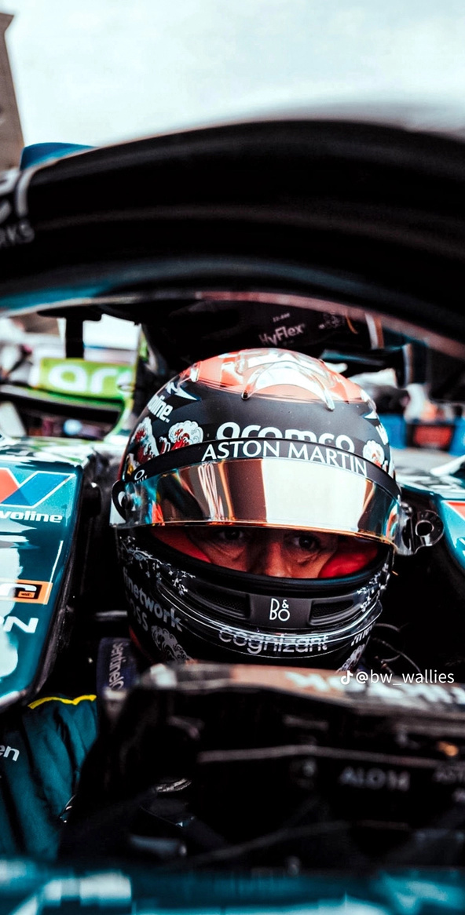
DATA DRIVEN INSIGHTS
Better Starting Position
Teams and drivers to commit fully during qualifiers
Lower average lap times
Hire better drivers and have more practice to improve their consistency
Lower fastest lap times
More investment into R&D
Lower average pit stop times
Increase amount of practice and employ better strategies

Slide 45
THANK
YOU

